Slide 1
CELLPHONE JAMMER
1.CH. Muralidhar
2.Shaik Baji
3.B. Suneetha
4.M. Kishore Kumar
5.P. Nagi Reddy

Slide 2
Contents
Mobile Information System Introduction
Problem Definition
System Design
Used Technologies
Wireless Application Protocol (WAP)
Middle Tire Technologies
Data Flow Diagrams
Implementation
Testing
Sample Screens
Conclusion and future scope

Slide 3
Software requirement Specification
User Interface:
HTML
Hardware Interfaces:
Processor : Pentium III With minimum 800Mhz
RAM : 256 MB RAM.
Software Interfaces:
Windows XP
Servlets, jdbc, tomcat server,wml.
Database Requirement:
Oracle

Slide 4

Introduction
Mobile Information System:
Mobile Information System it is a system, which enable the users to access information from a mobile device.
The example of a mobile device is not only a mobile phone a laptop A PDA and a notebook computer also come into the category of a mobile device.
Generalizing the definition we can say that a device, which uses the wireless communication technology, can be consider as a mobile device

Slide 5
Advantage
The advantages of this mobile information system are to develop application which handsets have a folder for applications to be downloaded and stored. Applications can be stand-alone, like many games or online services such as stock tracking.
2.When an application is no longer needed, it can be removed as easily as it was saved.
Disadvantage
Some complex images and effects cannot be shown in the mobile as we display in a WebPages.
Security should be maintained while delivering the any confidential information.

Slide 6
System Designing & Problem definition
The client is creating a request for some information, which is available in the database, but the database is not directly accessible to the user and there are some constraints like protocol compatibility problems these all should be considered and when you are developing the information system.
To overcome this problem we use “Three tire Architecture”.
Here in this three ties architecture the client requests to the middle tier which we also call as business tier which contains business logic which is responsible to process the client requests and prepare the response to the request and sends it back to the requested client.

Slide 7
The client side also the operating environment is different when we considering the device size and capacity we need to design the client interface. For that particular purpose we need to go for the new technologies like “WML”.
Used Technologies
The technologies used in this project and the tasks can be divided into three categories
Client side Interface Development
Middle Tire Development and putting it in the running mode
Database building.

Slide 8
Client side interface design and technologies used
Here we used WML for developing client side interface and WML Script for client side validations. And the most important thing is here we are using some simulators and toolkits at the development time here we are using the Nokia toolkit, which also provide a Micro Browser Simulator, and a gateway, which is responsible for protocol conversions.
What is WAP ?
WAP stands for Wireless Application Protocol
WAP is used to access Services and information
WAP is an application communication protocol
WAP uses the mark-up language WML

Slide 9
What is WML ?
WML stands for Wireless Markup Language. It is a mark-up language inherited from HTML, but WML is based on XML, so it is much stricter than HTML.
WML is used to create pages that can be displayed in a WAP browser. Pages in WML are called DECKS. Decks are constructed as a set of CARDS.
Examples of WAP use
Checking train table information
Ticket purchase
Viewing traffic information
Checking weather conditions
Looking up stock values

Slide 10
Middle tier Technologies
In the middle tier we need to write some business logic and the business logic need to be in running mode for client request handling. Here the business logic is written in the form of java’s httpservlets we are using only httpservlets because the client need to access the information from the web so he need to pass the http requests the protocol conversion takes place in the WAP gateway
Relationship to the Real World
Procedural and Structural programs are often difficult to design. The problem is that their chief components functions and data structures don't model the real world very well
To over come this problem oop is introduced

Slide 11
Modules
1. Faculty List
2. Result
2.1 Internal Result
2.2 External Result
3. Library Book Information
4. Notification
5. Events

Slide 12
Faculty List
This project is used to access the information about the faculty list like number of faculty in the college, subject they are dealing in the particular class, salary details, working hours etc. This information is gathered in the mobile information system.
Result
This project also deals with the results like internal results and external results
Exam conducted in the college to see the students performance are called as internal results. These results should be displayed in the mobile information system.
Exams which are conducted by the universities are called as external results. These results should be displayed in the mobile information system to the faculties or head of the departments

Slide 13
Library Information
This module explains the library details like number of books, author names, cost of these books etc. This information should be available in the mobile whenever they want to view it
Notification
This module explains the notifications of the college like notifications about exams, fees, holidays etc. This information should be available in the mobile to view these details.

Slide 14
Events
This module explains about the events in the college like sports in that year, cultural activities conducted in the college. This information is displayed in the mobile information system. This helps us to retrieve the data efficiently.

Slide 15
Data Flow Diagrams
Data flow diagram is a structure analysis tool that is used for graphical representation of Data processes through any organization.
A full description of a system actually consists of set of DFD s, which comprises of various levels.
The transformation of data from one process to another process is independent of physical components. These types of DFD’s are called LOGICAL DATA FLOW DIAGRAMS
DFD’s Gives just blue print of any project.

Slide 16
Mobile user
Mobile
Information
system
Mobile user
database
Mobile user
Context Level Dataflow Diagram

Slide 17
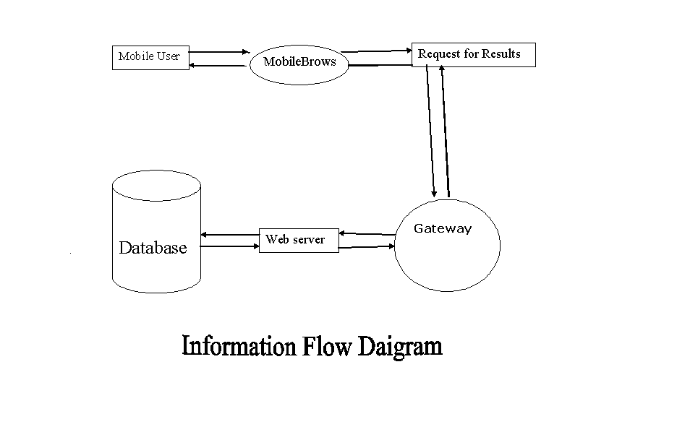

Slide 18
UML DIAGRAMS

Slide 19
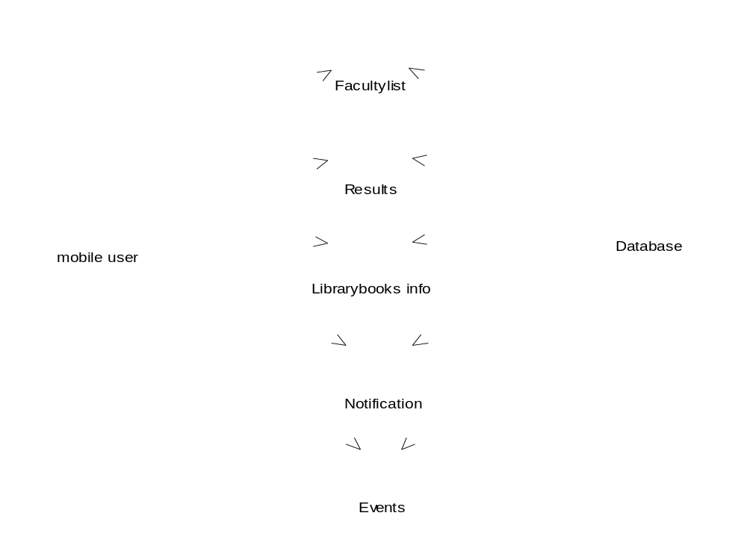
Fig :Use case diagram for Mobile Information System

Slide 20
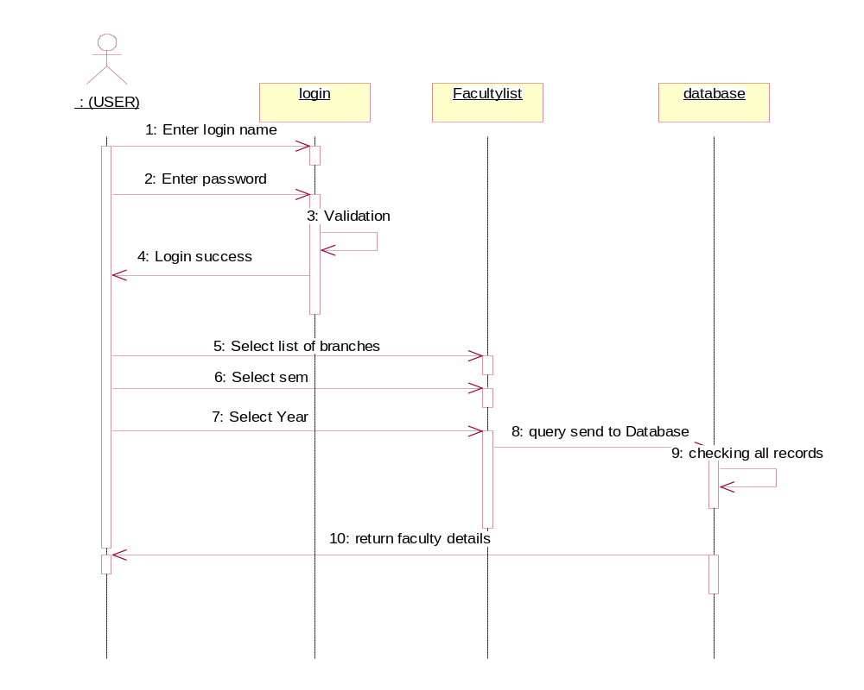
Fig : Sequence diagram for Faculty list

Slide 21
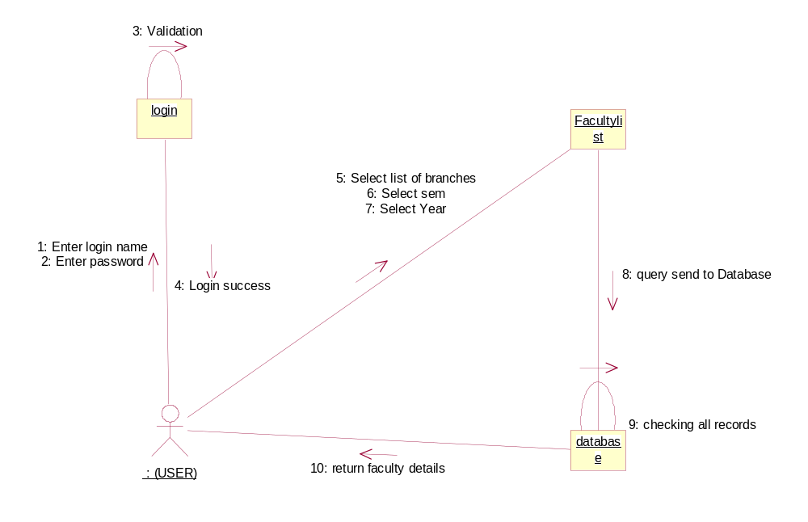
Fig : Collaboration diagram for Faculty list

Slide 22
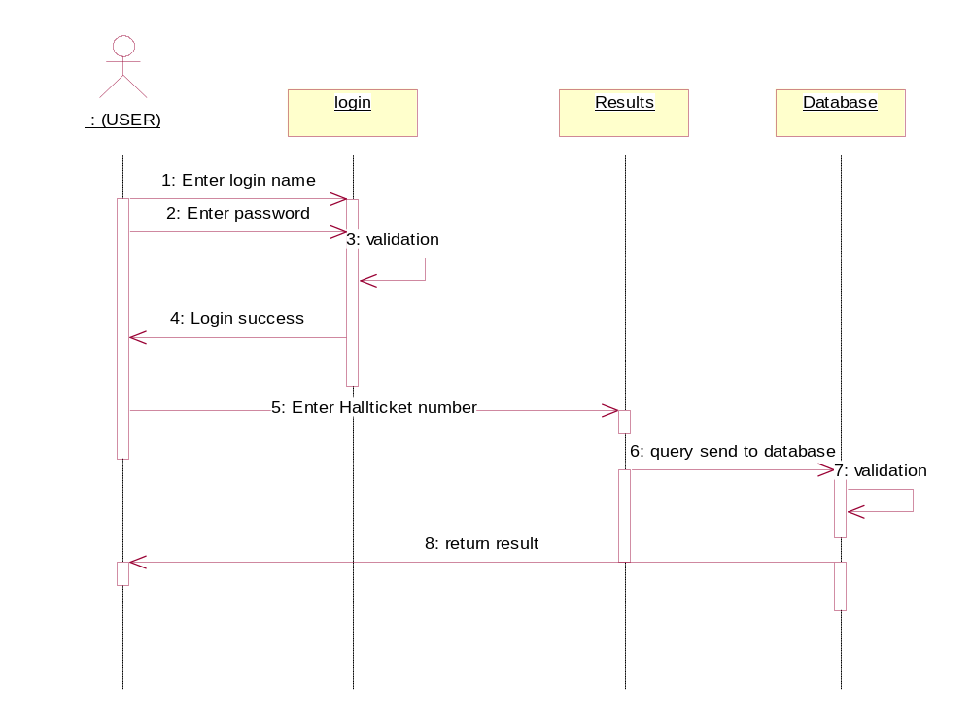
Fig : Sequence diagram for Results

Slide 23
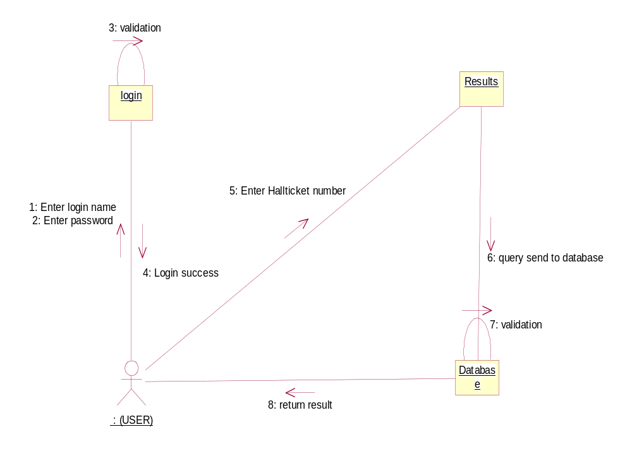
Fig : Collaboration diagram for Results

Slide 24
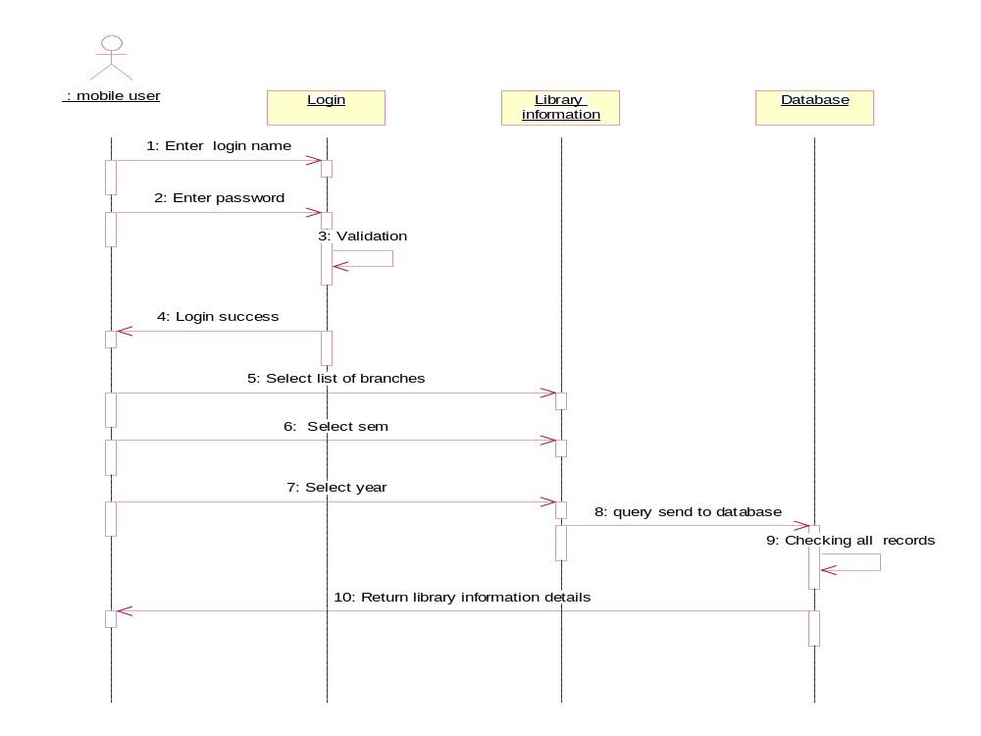
Fig : Sequence diagram for Library information

Slide 25
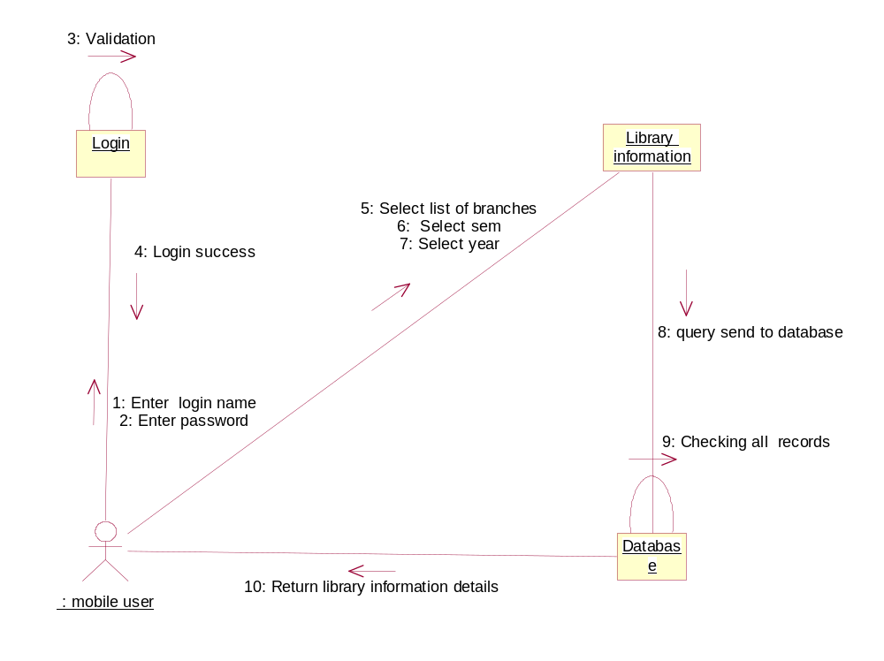
Fig : Collaboration diagram for Library information

Slide 26
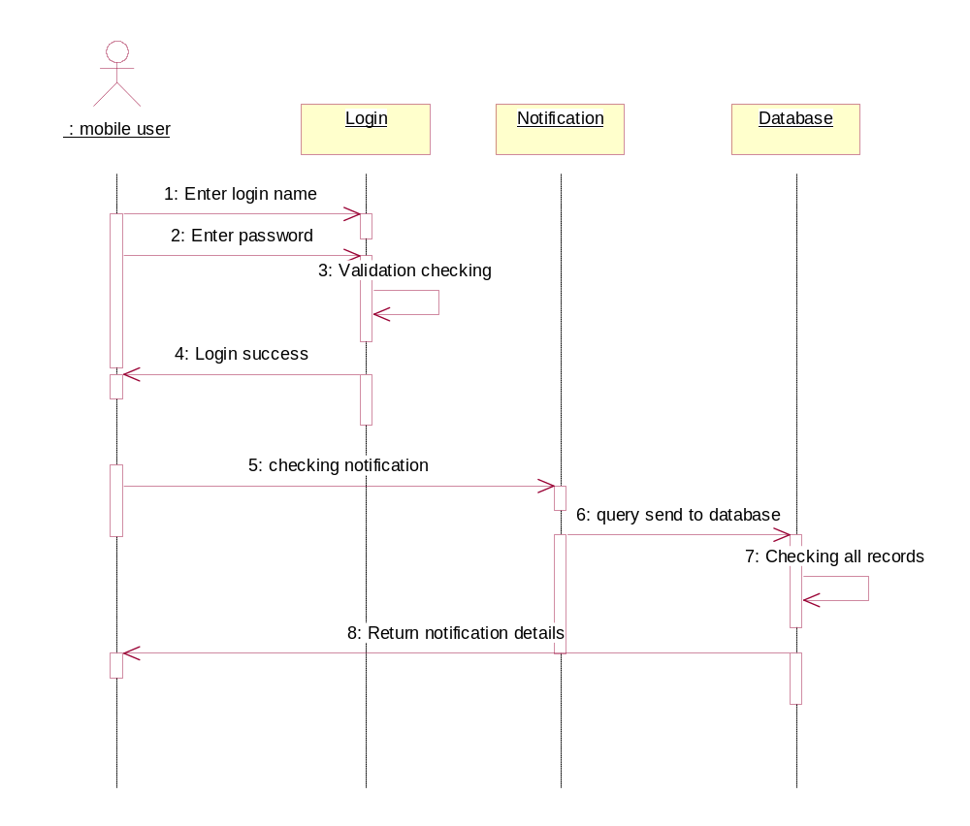
Fig : Sequence diagram for Notification

Slide 27
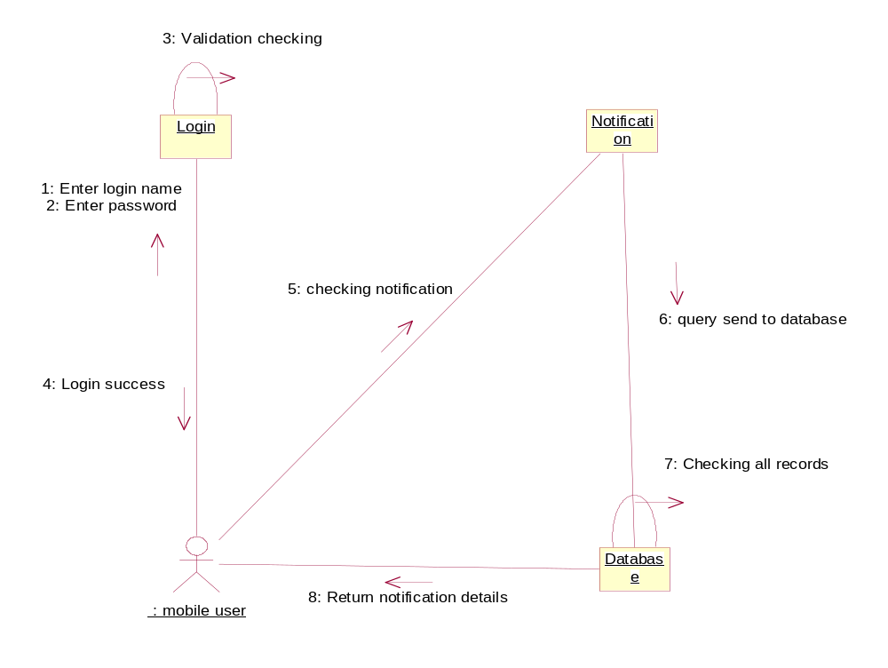
Fig : Collaboration diagram for Notification

Slide 28
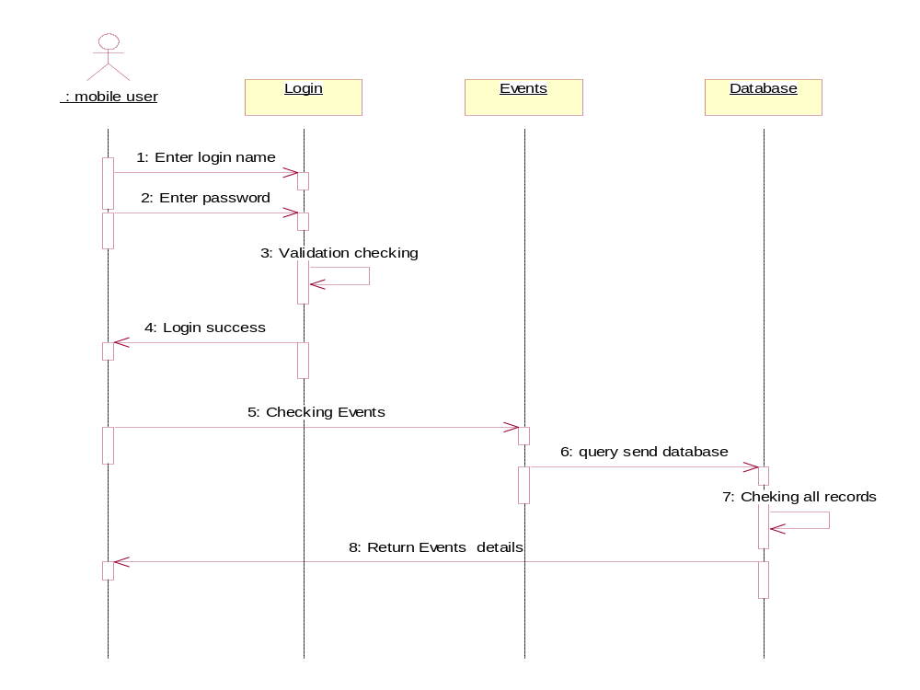
Fig : Sequence diagram for Events

Slide 29
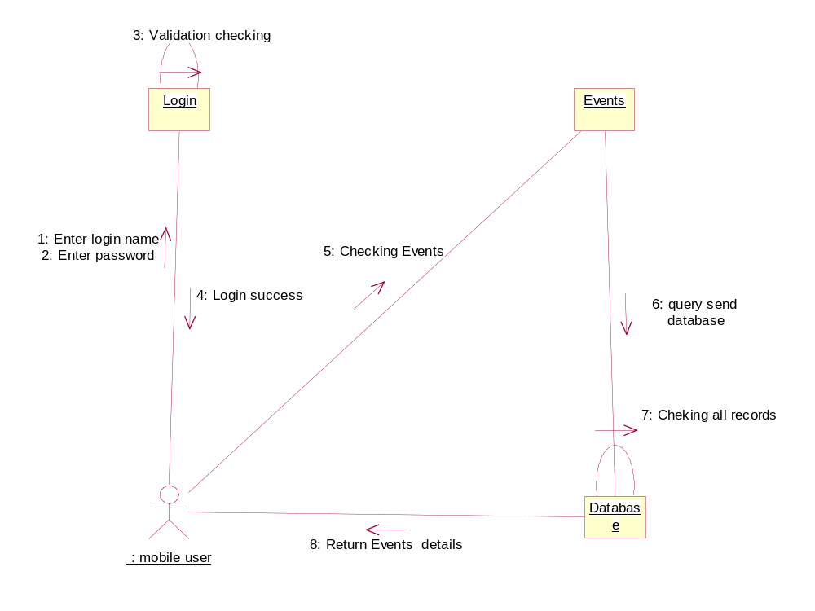
Fig : Collaboration diagram for Events

Slide 30
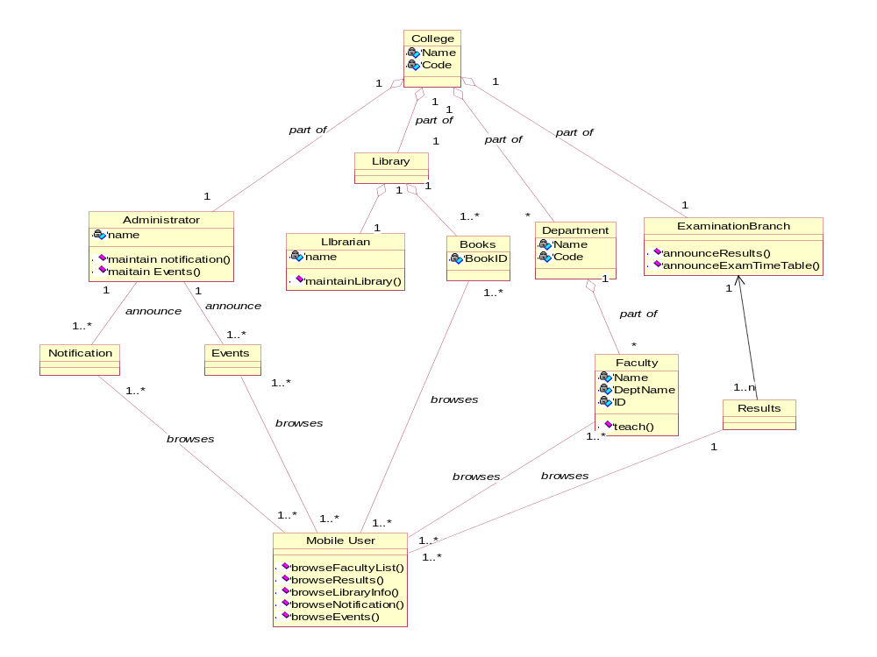
Fig : Class diagram for Mobile Information System

Slide 31
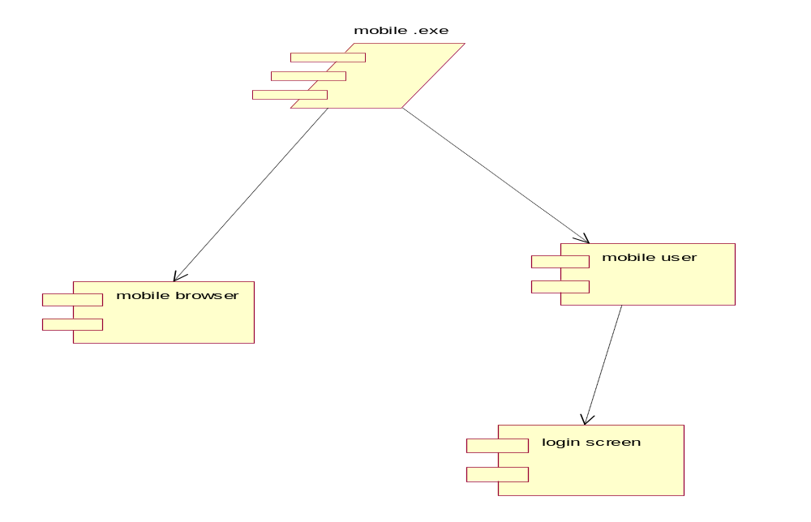
Fig : Component diagram for Mobile Information System

Slide 32
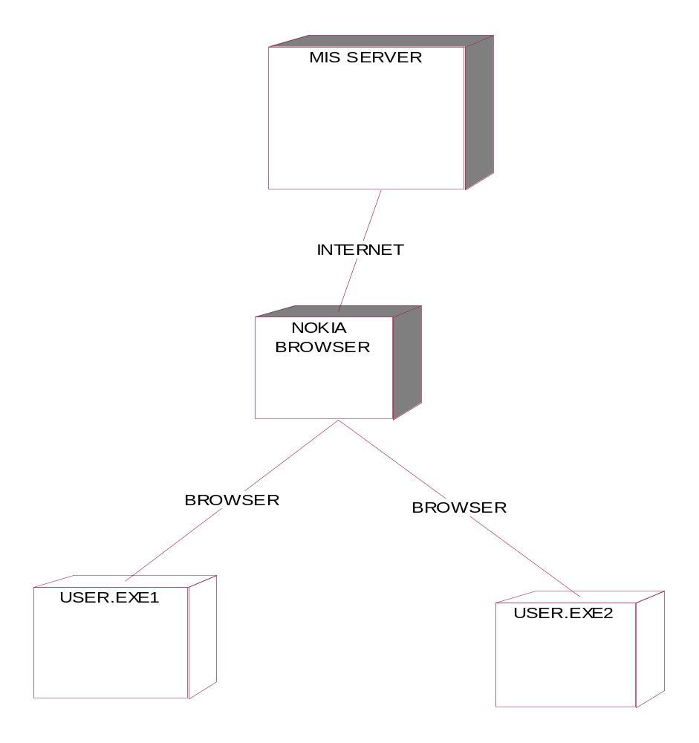
Fig : Deployment diagram for Mobile Information System

Slide 33
Implimentation
Implementation Done Through WML, Servelets
The Screens Designing is through WML Manipulation is Through servelets
We can get the entire information from the database through servelets into Mobile Simulator
Waterfall Model
In this model developers follow these steps in order. They state requirements, analyze them, design a solution approach, architect a software framework for that solution, develop code, test, deploy, and maintain. After each step is finished, the process proceeds to the next step.

Slide 34
TESTING
Testing is the major quality control measure employed for software development. Its basic function is to detect errors in the software.
During requirement analysis and design, the output is document that is usually textual and non-textual.
After the coding phase, computer programs are available that can be executed for testing purpose.
Thus, the goal of testing is to cover requirement, design, or coding errors in the program

Slide 35
Testing Techniques
During testing, the program is executed with a set of conditions known as test cases and the output is evaluated to determine whether the program is performing as expected.
UNIT Testing
Unit Testing is done on individual modules as they are completed and become executable. It is confined only to the designer's requirements
Black Box Testing
In this strategy some test cases are generated as input conditions that fully execute all functional requirements for the program
In this testing only the output is checked for correctness. The logical flow of the data is not checked.

Slide 36
White Box Testing
In this the test cases are generated on the logic of each module by drawing flow graphs of that module and logical decisions are tested on all the cases
It has been uses to generate the test cases in the following cases:
Guarantee that all independent paths have been executed
Execute all logical decisions on their true and false sides
Execute internal data structures to ensure their validity
Execute all loops at their boundaries and within their operational bounds.

Slide 37
SAMPLE SCREENS

Slide 38
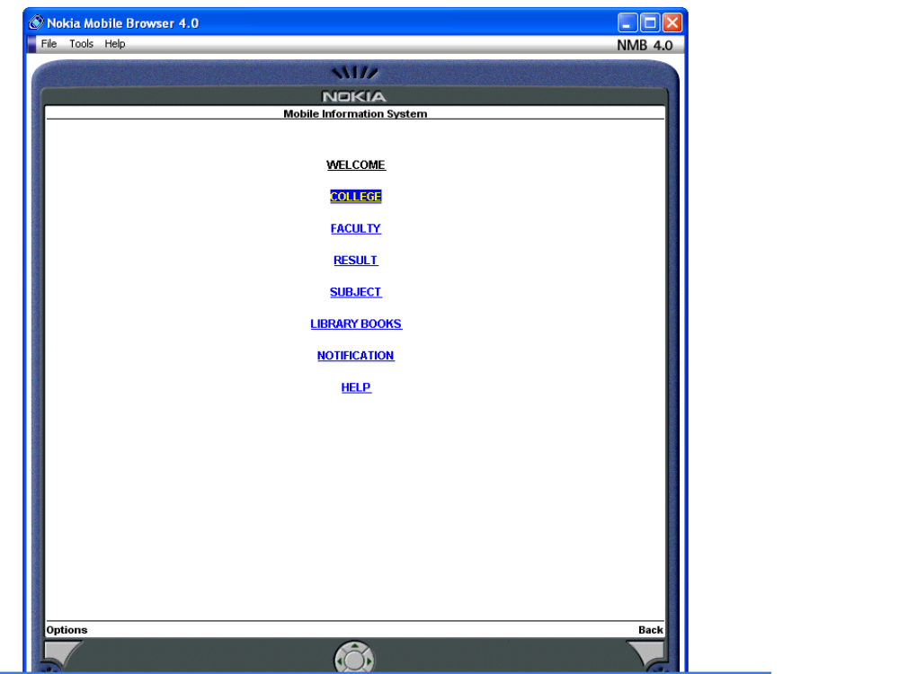

Slide 39
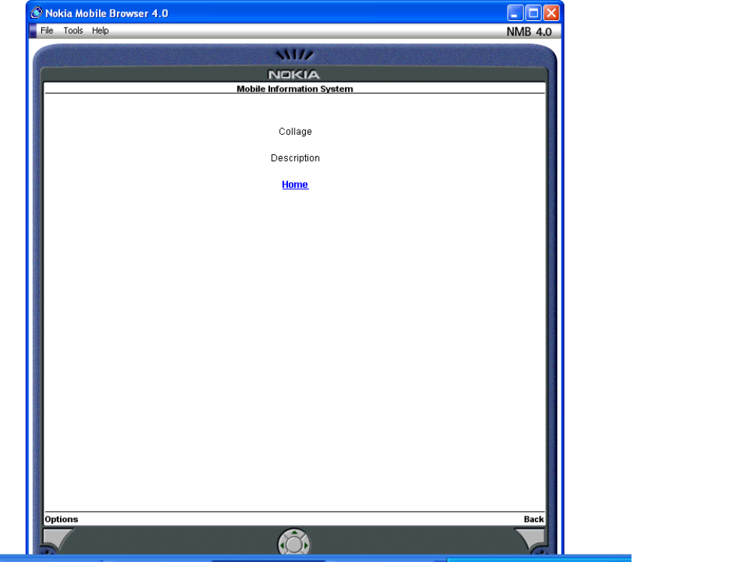

Slide 40
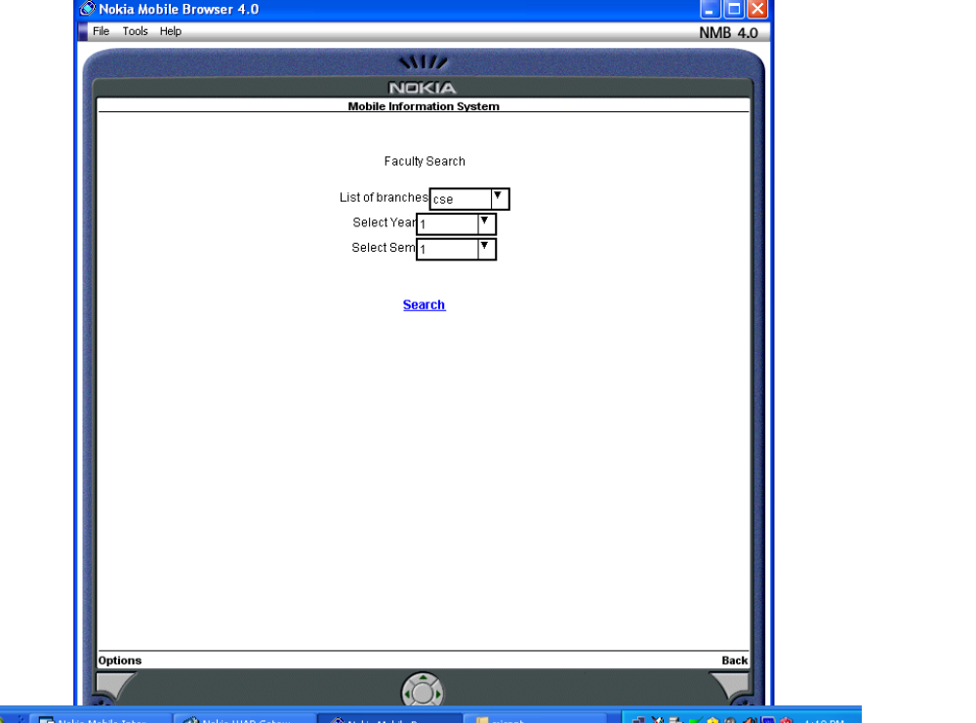

Slide 41
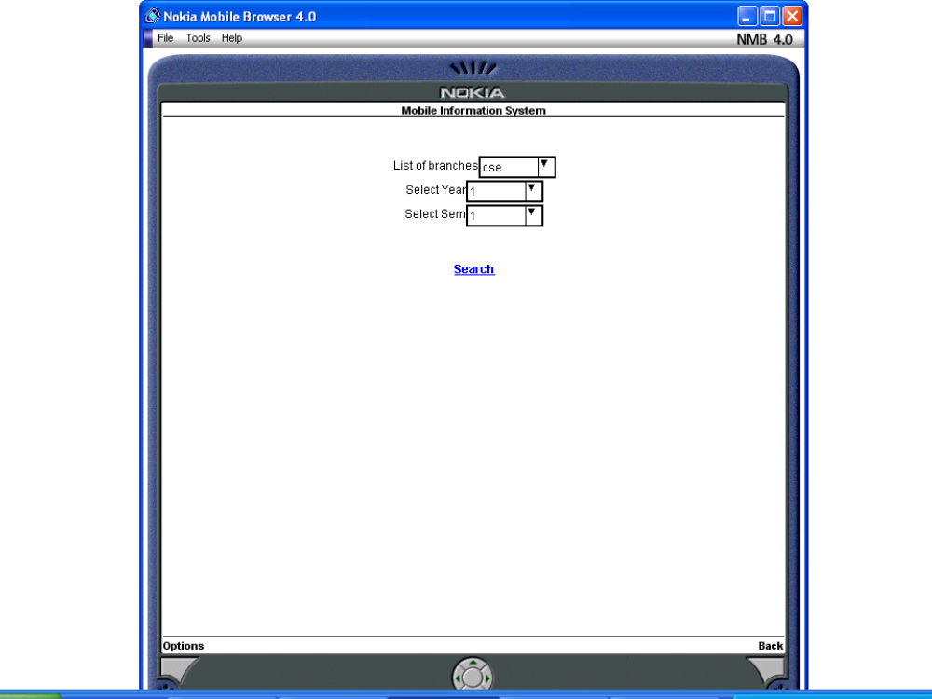

Slide 42
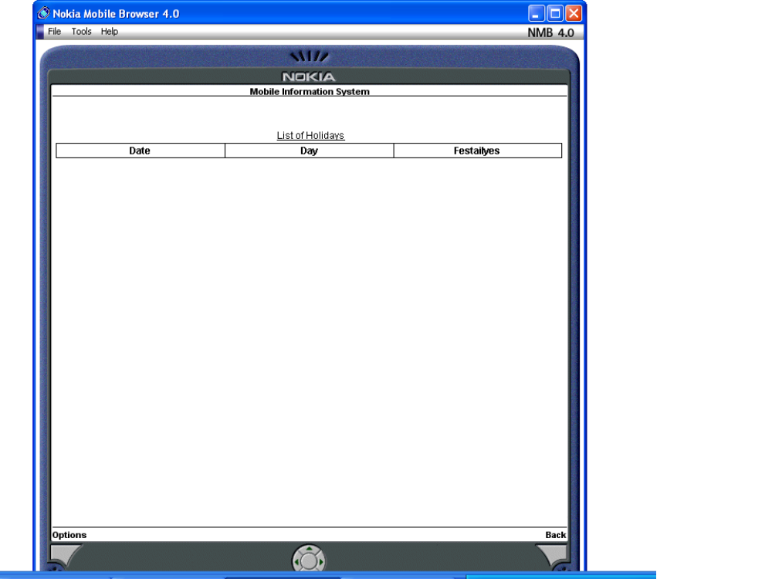

Slide 43
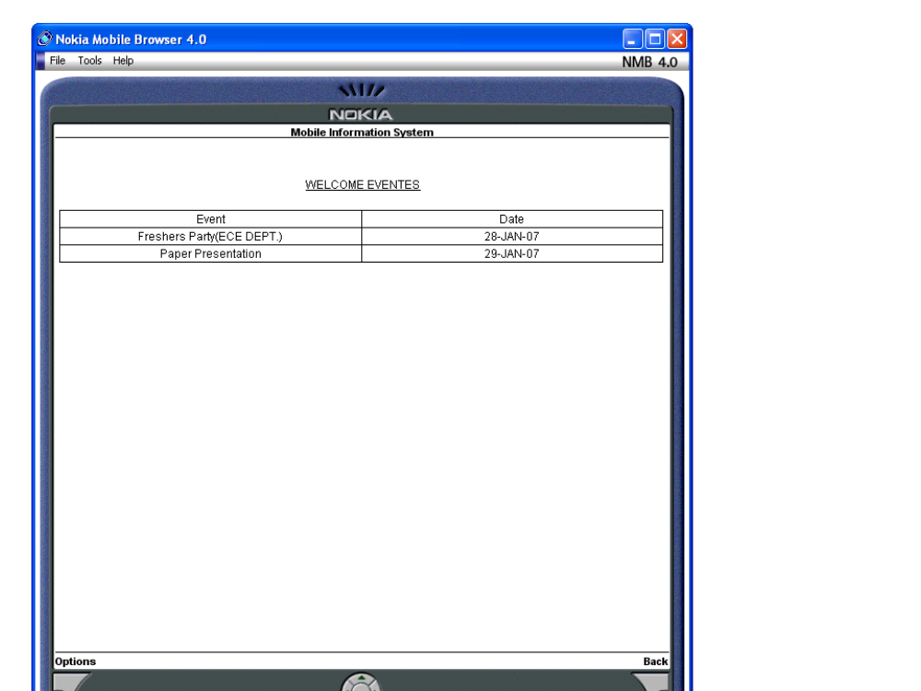

Slide 44
Conclusion
The project is very successfully handles the hundreds of requests made by the clients event though they are making requests at a single fraction of time. The future scope for this project is we can develop a entire college or university WAP site, we can provide SMS and MMS like services to compatible users. That means we need to change the entire systems requirements and implementation

